Slide 1
MAKING THE WORLD A BETTR PLACE TO STAY
PRESENTATION BY NTSOAKI MOKALA

Slide 2
LEARNING OBJECTIVES
In this projects learners will be able to:
Improve their research skills
Make use of technological skills in learning
Use critical skills to solve real-world problem

Slide 3
LEARNING ACTIVITIES DETAILS
In this project learners will be incorporating technological skills in their learning. The main focus is on studying social and environmental justice, spreading the knowledge on how each individual can contribute in the achievement of social and environmental responsibility. At the end of the day, each person’s human rights will be enhanced and respected: a right to a safe and clean environment can be achieved.

Slide 4
21st CENTURY SKILLS
Collaboration
Knowledge building
Problem solving
ICT for learning
Self-regulation

Slide 5
SELF REGULATION
Learners meet regularly to evaluate their progress and check on how to improve their activities.
Also each indivual also talks of the challenges or any achievements on the assignments they have to complete

Slide 6
INSTRUCTIONAL APPROACH
Project based learning
Personalized learning
Direct Instruction
Independent study

Slide 7
FEATURED TOOLS
Autocollage
Powerpoint presentation
Facebook
Binu
Youtube

Slide 8
COLLABORATION
Learners created a face book page
Collected pictures and created collages
Assumed different roles: researcher, photographer ,editor and project manager

Slide 9
KNOWLEDGE BULDING
Known concepts: human rights, social and environmental justice and responsibility
Learners build on the knowledge they already have and explore the unknown

Slide 10
PROBLEM SOLVING
In this category learners are solving a real world problem: CLIMATE CHANGE
Climate change affects each and everyone of us globally , so learners are coming up with ways on whic how each individual can contribute to make a difference

Slide 11
ICT FOR LEARNING
Learners incorporate the use of ICT in their learning
Devices used are: phone and a PC, use of different software

Slide 12
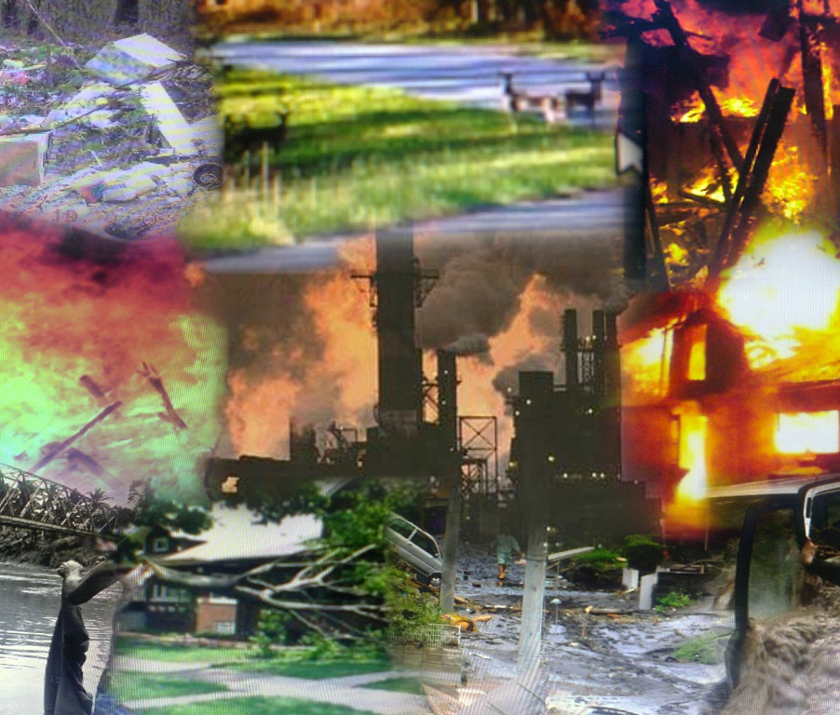
NATURAL DISASTERS
Floods
Winds
Wild fires
Storms
radiation

